Slide 1

Problem Solving skills
Course Code: CSC -101 Credit Hrs:3+1
Course Teacher: Javeria Farooq

Slide 2
Problem Solving
As the computer is also a device similar to the way in which the human brain functions, the process of calculating the sum of two values can also be easily performed by the computer.
=

Slide 3
Problem Solving
Processing
(Brains)
Input
Output

Slide 4
Problem Solving
Output Device
CPU
(Brains)
Input Device

Slide 5
Problem Solving
Processing
5
10
5 + 10 = 15
15
Input
Output
Let us assume we are interested in calculating the sum of 5 and 10.

Slide 6
Algorithm
Refers to the logic of a program
It is a step-by-step description of how to arrive at the solution of a given problem
A computer program is simply an algorithm for a computer that is written in a programming language.

Slide 7
Quality of Algorithm
An algorithm must possess the following properties
(i) Finiteness : An algorithm must terminate in a finite number of steps.
(ii) Definiteness : Each step of the algorithm must be precisely and unambiguously stated.
(iii) Effectiveness : Each step must be effective, in the sense that it should be easily convertible into program statement.
(iv) Generality : The algorithm must be complete in itself so that it can be used to solve all problems of a specific type for any input data.
(v) Input / Output : Each algorithm must take zero, one or more inputs.

Slide 8
How to express an ALGORITHM?
The constructs used to build algorithms can be described in two different ways:
Pseudo code
Flowchart

Slide 9
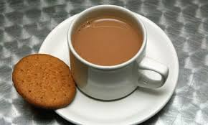
Algorithm Writing (Making a cup of tea)
Step 1: Boil Milk.
Step2: Add tea dust and sugar.
Step 3: Wait for the boil to come.
Step4: Tea is ready.

Slide 10
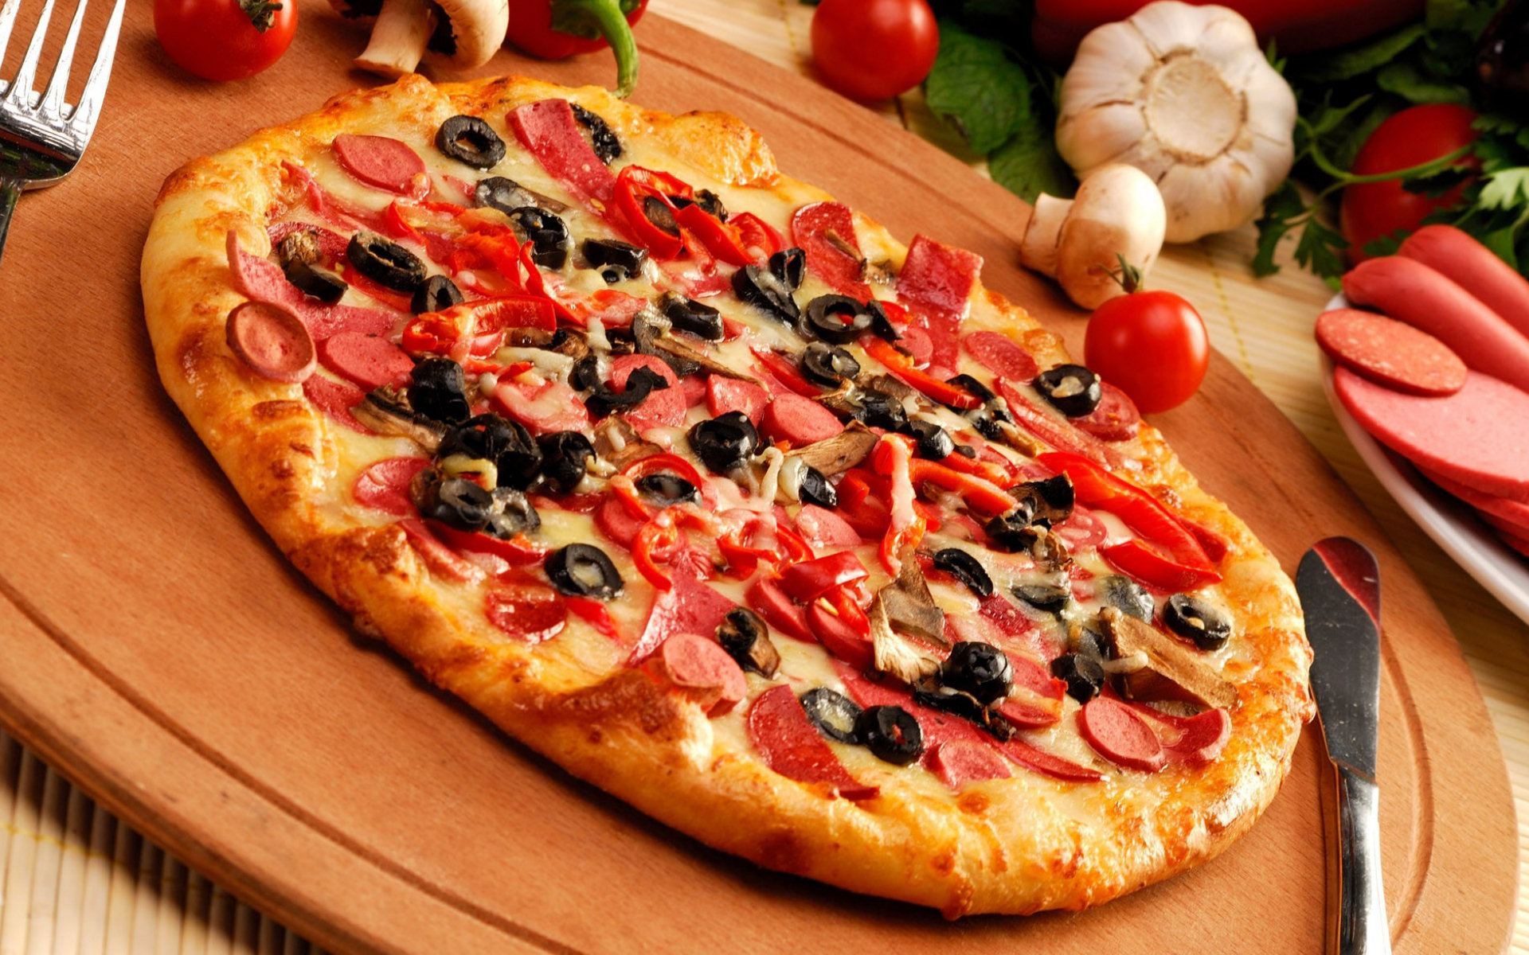
Algorithm Writing (Ordering Pizza)

Slide 11
Sample Algorithm (Example 1)
Write an algorithm to convert the length in feet to centimeter.
Algorithm
Step 1: Start
Step 2: Read Length_in_feet.
Step 3: Calculate length in cetimeter as Length_in_centimeter ← Length_in_feet * 30
Step 4: Print Length_in_centimeter
Step 5: Stop

Slide 12
Sample Algorithm(Example 2)
Write an algorithm that will read the two sides of a rectangle and calculate its area.
Algorithm
Step 1:Start
Step 2: Read the Width and Length
Step 3: Calculate the area as
Area ← Length * Width
Step 4: Print Area
Step 5: Stop
Width
Length

Slide 13
Sample Algorithm (Example 3)
Write an algorithm that will read three numbers, add them together and print their total.
Algorithm
Step 1: Start
Step 2: Read three numbers, num1, num2, num3
Step 3: Calculate the total
total ←num1+num2+num3
Step 4: Print total
Step 5: Stop

Slide 14
Sample Algorithm (Example 4)
Write an algorithm to calculate the perimeter and area of rectangle. Given its length and width.
Algorithm
Step 1: Start
Step 2: Read length and width of the rectangle L , W.
Step 3: Calculate perimeter of the rectangle
perimeter ← 2* (L+ W)
Step 4: Calculate area of the rectangle
area ← L*W.
Step 5: Print perimeter , area.
Step 6: Stop.
Width
Length

Slide 15
Sample Algorithm (Example 5)
Write an algorithm to find the average of three numbers.
Algorithm
Step1: Start
Step 2 Read the numbers a, b, c
Step 3:Compute the sum of a, b and c
sum ← a+b+c
Step 4: Divide the sum by 3 and store the result in avg
avg← sum/3
Step 5: Print the value of avg
Step 6: Stop

Slide 16
Pseudo code

Slide 17
Pseudo Code
General algorithm.
A Pseudo code language is semiformal, English-like language with a limited vocabulary that can be used to design and describe algorithms.
“Pseudo” means mock or false and “Code” refers to the instructions written in a programming language.

Slide 18
Sample Pseudo code (Example 1)
Pseudo code
Input the length_in_feet
Length_in_centimeter =Length_in_feet *30
Print length_in_centimeter
Algorithm
Step 1: Start
Step 2: Read Length_in_feet.
Step 3: Calculate length in cetimeter as Length_in_centimeter ← Length_in_feet * 30
Step 4: Print Length_in_centimeter
Step 5: Stop

Slide 19
Sample Pseudo code(Example 2)
Pseudo code
Input the width and Length of a rectangle
Area =Length * Width •
Print Area
Algorithm
Step 1:Start
Step 2: Read the Width and Length
Step 3: Calculate the area as
Area ← Length * Width
Step 4: Print Area
Step 5: Stop

Slide 20
Logical Structure of Pseudo code
Pseudo code is made up of the following logic structures that have been proved to be sufficient for writing any computer program:
Sequence Logic
Selection Logic
Iteration Logic

Slide 21
Sequence Logic
It is used to perform instructions in a sequence, that is one after another.
Thus, for sequence logic, pseudo code instructions are written in an order in which they are to be performed.
The logic flow of pseudo code is from top to bottom.

Slide 22
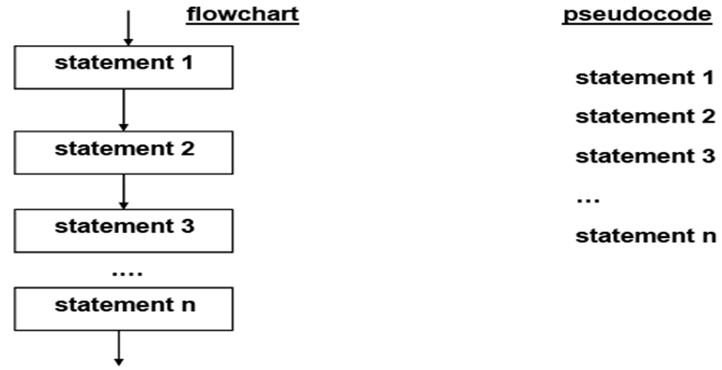
Sequence Logic

Slide 23
Selection Logic
It is used for making decisions and for selecting the proper path out of two or more alternative paths.
It is also known as decision logic.
Selection logic is depicted as either an IF...THEN or an IF...THEN...ELSE structure

Slide 24
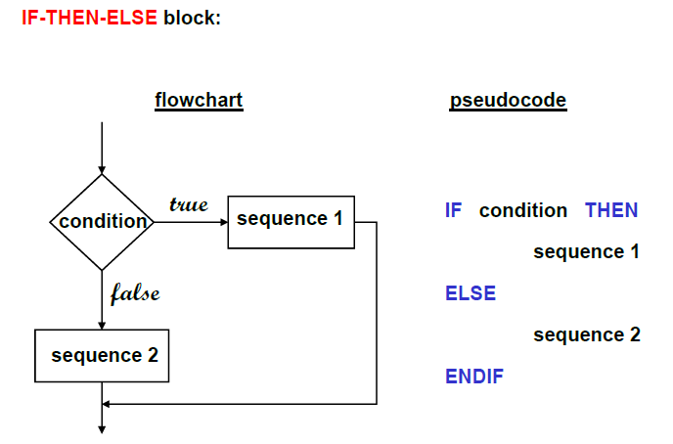
Selection Logic

Slide 25
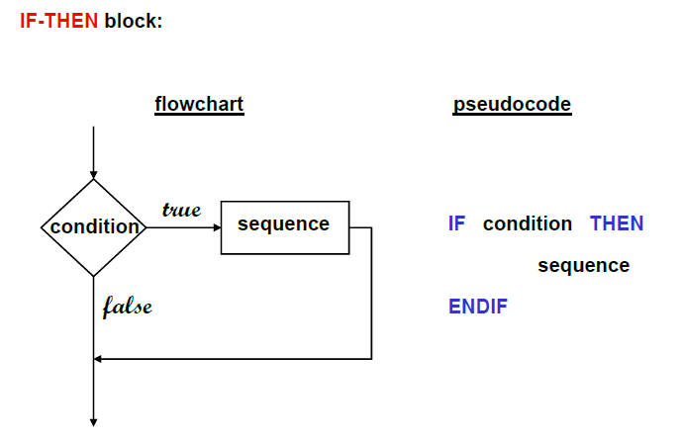
Selection Logic

Slide 26
Iteration Logic
It is used to produce loops when one or more instructions may be executed several times depending on some of the conditions.
It uses structures called the WHILE, FOR and the REPEAT_UNTIL.

Slide 27
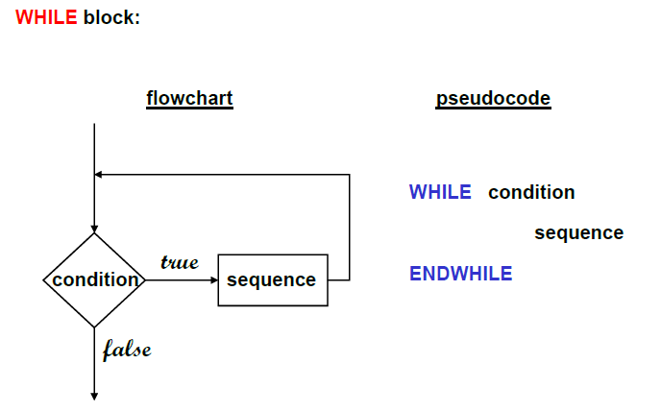
Iteration Logic

Slide 28
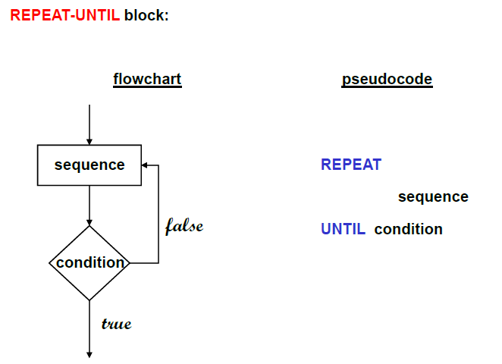
Iteration Logic

Slide 29
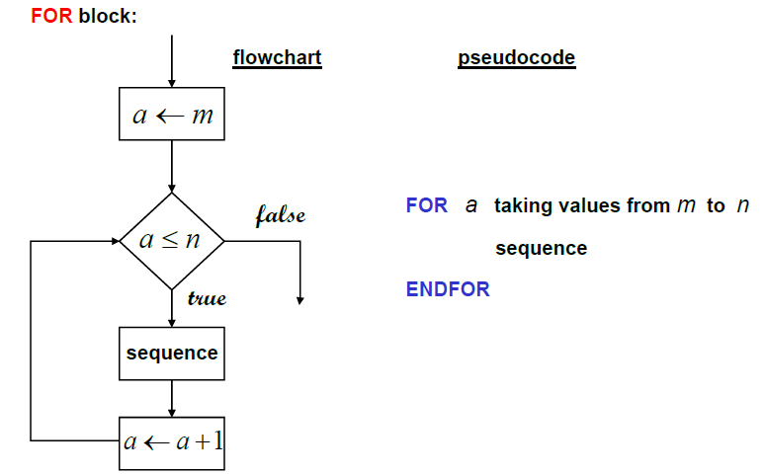
Iteration Logic

Slide 30
Flowchart

Slide 31
Flowchart
Flowchart is a pictorial representation of an algorithm
Uses symbols (boxes of different shapes) that have standardized meanings to denote different types of instructions
Actual instructions are written within the boxes
Boxes are connected by solid lines having arrow marks to indicate the exact sequence in which the instructions are to be executed
Process of drawing a flowchart for an algorithm is called flowcharting

Slide 32
Rules of Flowcharting
Be consistent in using names and variables in the flowchart
Keep the flowchart as simple as possible. Crossing of flow lines should be avoided as far as practicable
If a new flowcharting page is needed, it is recommended that the flowchart be broken at an input or output point.
Do not chart every detail of the program. A reader who is interested in greater details can refer to the program itself
Words in the flowchart symbols should be common statements and easy to understand

Slide 33
Flowchart Symbols
Flowchart Symbol | Name | Description
 | Process | An operation or action
 | Terminator | A start or stop in a program
 | Decision | A question or branch in a program
 | Input/ Output | Indicates data inputs or outputs
 | Flow Line | Indicates direction of program flow
 | Connector | Connect two flowchart segments.

Slide 34
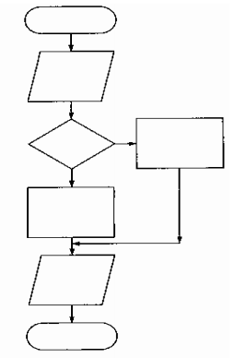
Any Program Using Flowchart Would Be
Start.
Read some information.
Make a decision.
On the basis of that decision , carry out one process or the other.
Print a result in either case.
Stop.

Slide 35
Flowchart (Example 1)
Algorithm
Step 1: Start
Step 2: Read Length_in_feet.
Step 3: Calculate length in cetimeter as Length_in_centimeter ← Length_in_feet * 30
Step 4: Print Length_in_centimeter
Step 5: Stop
START
Read
Length _in_feet
Length_in_centimeter= Length_in_feet* 30
Print
Length_in_centimeter
STOP

Slide 36
Flowchart(Example 2)
Algorithm
Step 1: Start
Step 2: Read the Width and Length
Step 3: Calculate the area as
Area ← Length * Width
Step 4: Print Area
Step 5: Stop
START
Read
Width , Length
Area = Length * Width
Print
Area
STOP

Slide 37
Flowchart (Example 3)
Algorithm
Step 1: Start
Step 2: Read three numbers, num1, num2, num3
Step 3: Calculate the toal
total ←num1+num2+num3
Step 4: Print total
Step 5: Stop
Start
Read num1, num2,
num3
Total=num1+num2+num3
Print total
Stop

Slide 38
Flowchart (Example 4)
Algorithm
Step 1: Start
Step 2: Read length and width of the rectangle L , W.
Step 3: Calculate perimeter of the rectangle
perimeter ← 2* (L+ W)
Step 4: Calculate area of the rectangle
area ← L*W.
Step 5: Print perimeter , area.
Step 6: Stop.
Start
Read L,w
perimeter=2*(L+W)
area= L*W
Print perimenter, area
Stop

Slide 39
Flowchart (Example 5)
Algorithm
Step1: Start
Step 2: Read the numbers a, b, c
Step 3: Compute the sum of a, b and c
sum ← a+b+c
Step 4: Divide the sum by 3 and store the result in avg
avg← sum/3
Step 5: Print the value of avg
Step 6: Stop
Start
Read a,b,c
sum=a+b+c
avg=sum/3
Print avg
Stop

Slide 40
PROBLEM SOLVING TECHNIQUE
1. Problem
Write an algorithm to convert the length in feet to centimeter.
2. Analyze the Problem
Input | Process | Output
Length_in_feet | Length_in_ cm=Length_in_ft with 30 | Length_in_centimeter

Slide 41
PROBLEM SOLVING TECHNIQUE
3. Design the Algorithm
Pseudocode Read length_in_feet Length_in_centimeter =Length_in_feet *30 Print length_in_centimeter
START
Read
Length _in_feet
Length_in_centimeter= Length_in_feet* 30
Print
Length_in_centimeter
STOP
4. Code

Slide 42
Exercises
Design a problem solving technique to calculate the simple interest using the formula.
Simple interest = P*N*R/100 where P is principle Amount, N is the number of years and R is the rate of interest.
2.Design a problem solving technique to read in the max. and min. temperature on a particular day and calculate and print the average temp.
3.A student appears in an examination, which consists of total 10 subjects, each subject having maximum marks of 100. The roll number of the student, his/her name, and the marks obtained by him/her in various subjects are supplied as input data. Design a problem solving technique to calculate the percentage marks obtained by the student in this examination and then to print it along with his/her roll number and name.

Slide 43
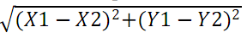
Exercises
4.Design a problem solving technique to convert a temperature from degrees Fahrenheit to degrees Celsius.
Hint: Celsius = 5/9 * (Fahrenheit – 32).
5.Design a problem solving technique that accepts two numbers and computes their sum, difference, product, and quotient.
6.You work in a store that sells imported fabric. Most of the fabric you sell is measured in square yards, but your customers want to know the equivalent amount in square meters. Design a problem solving technique to solve this problem.
Hint: 1 square meter= 1.198 yards.
7. Design a problem solving technique that computes the distance between two points (X1, Y1) and (X2,Y2).
Hint: Distance =
Notes:
9/5*celcius + 32
Y/1.98

